Slide 1
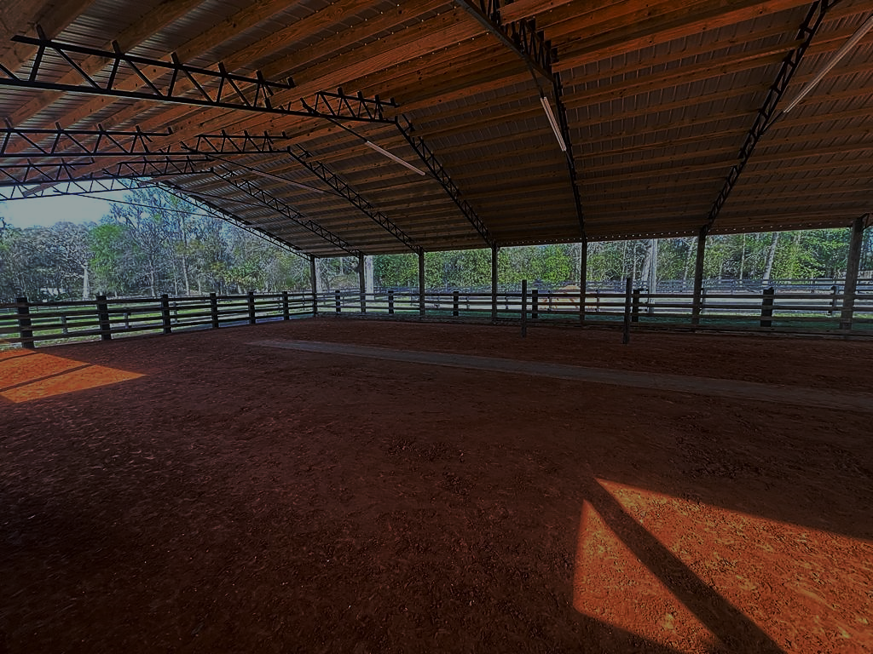
THE SIMILARITIES AND DIFFERENCES OF PFHA EQUITATION GUIDELINES & PFHA INTERNATIONAL EQUIATATION Ethomar Francisco Update 2/27/23 to 2022 Rulebook PADB

Slide 2
EQUITATION
- The art and practice
of riding a horse.

Slide 3
PFHA EQUITATION
The class is to be judged 100% on riders equitation.
The rider should exhibit a deep seat, while having harmony, style, grace and rhythm with their horse.
The rider shall convey the impression of effective and complete control at all times, showing both the horses and the rider.

Slide 4
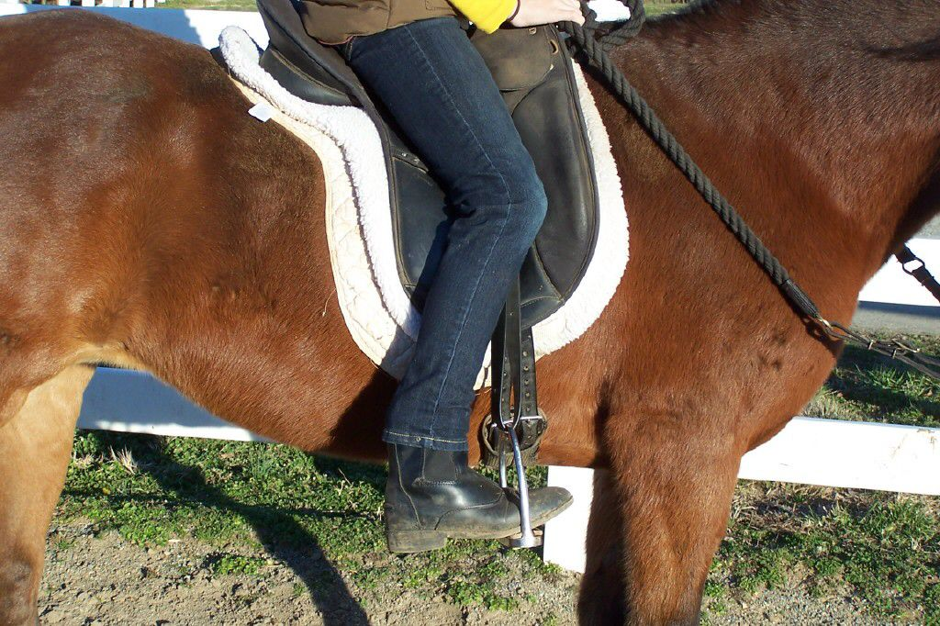
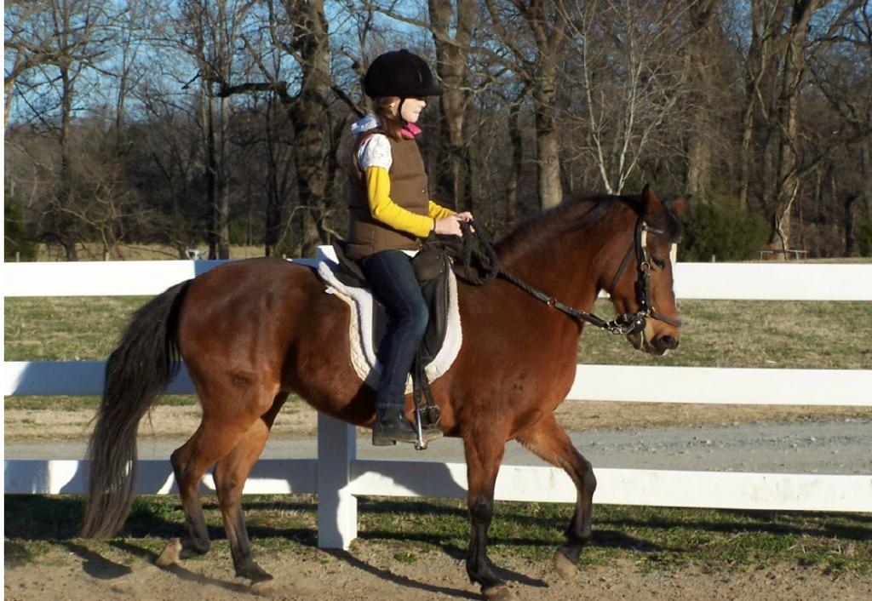
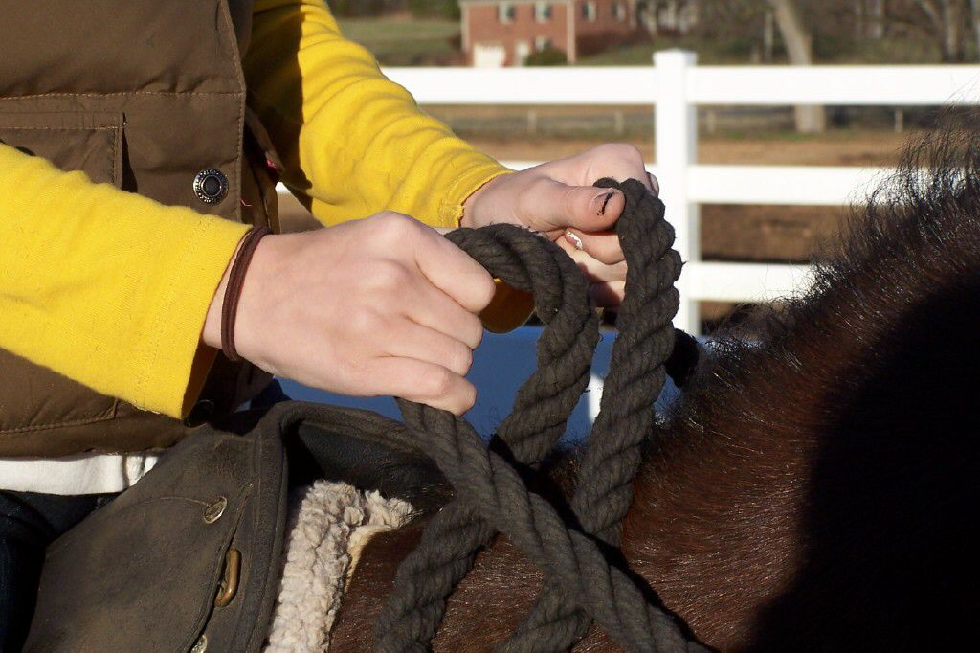
PFHA
POSTURE
. Arm and Hand Position
. Head Position
. Back Position
. Feet and Leg Position
. Position in Motion

Slide 5
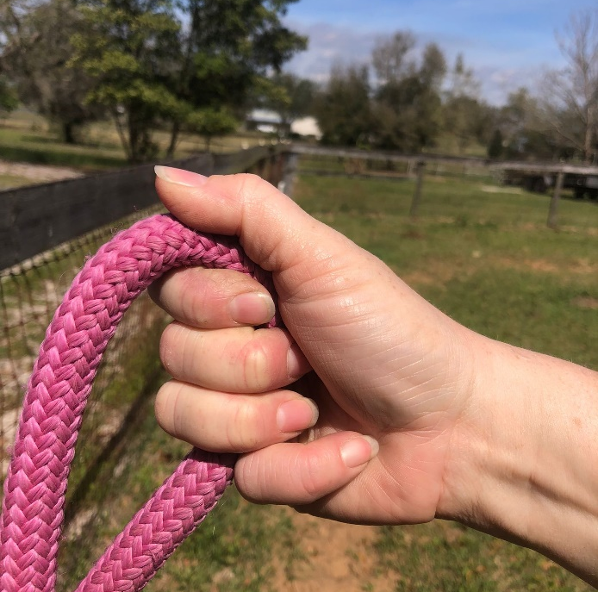
REIN HOLD
PFHA

Slide 6
Procedrue
PFHA EQUITATION CLASS
Paso corto
Paso largo
Walk
Reverse and continue in walk
Paso corto
Halt
Paso corto
Paso largo
Walk
Reverse and continue in walk
Paso corto
Line up

Slide 7
PFHA TEST
Ride without stirrups at a Paso Corto, maintaining the proper position. 13 years and older
Back his or her horse smoothly and under control*
Dismount and mount. 13 years and older
Perform a figure eight (8) at Paso Corto 13 years and older
Move his or her horse from Paso Largo to a Walk on a quiet rein*.
Answer questions on parts of the horse and tack.*
*sub junior acceptable tests

Slide 8
PFHA

Slide 9
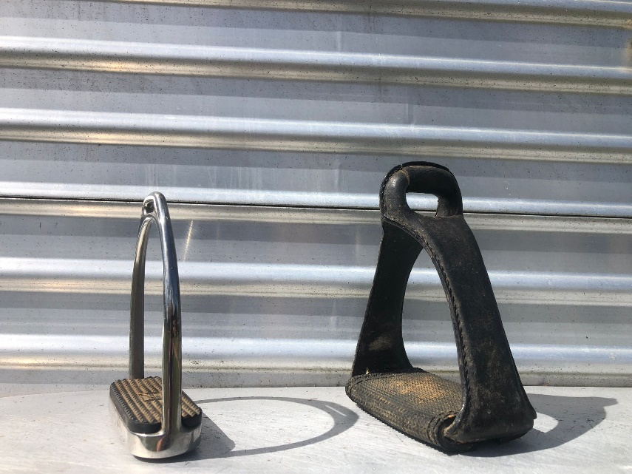
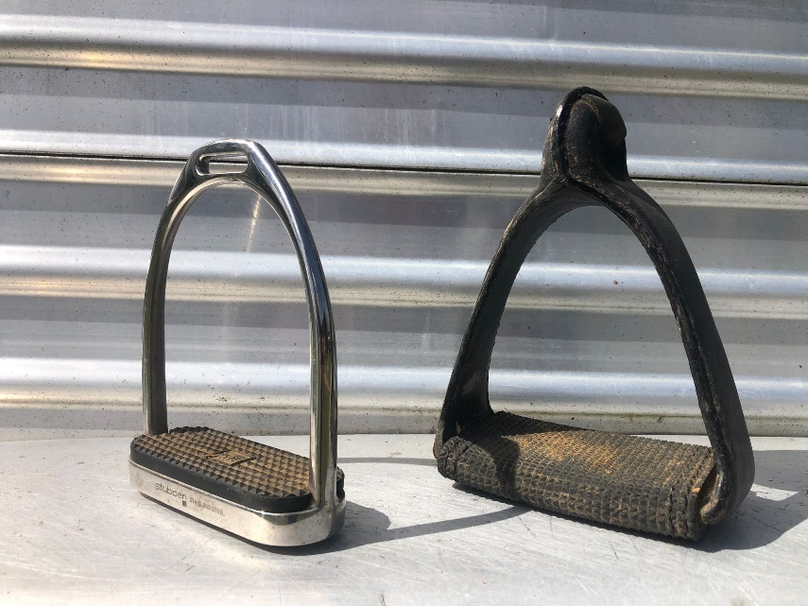
STIRRUP
English irons
Either class
Leather covered
Not Acceptable
Considered Western
PFHA
INTERNATIONAL
EQUITATION

Slide 10
INTERNATIONAL EQUITATION
• 60% management and oneness with rider and horse
• 40% Riders body positioning.
• Horse must maintain the gait
• Test of figure 8, halt, back, serpentine, and sounding board are mandatory.
• Additional test are optional and used for tie-breakers

Slide 11
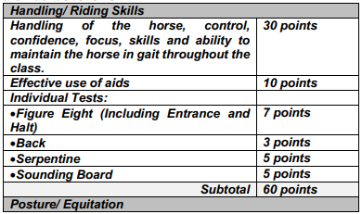
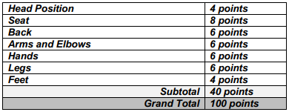
HANDLING / RIDING SKILS
POSTURE / EQUITATION

Slide 12
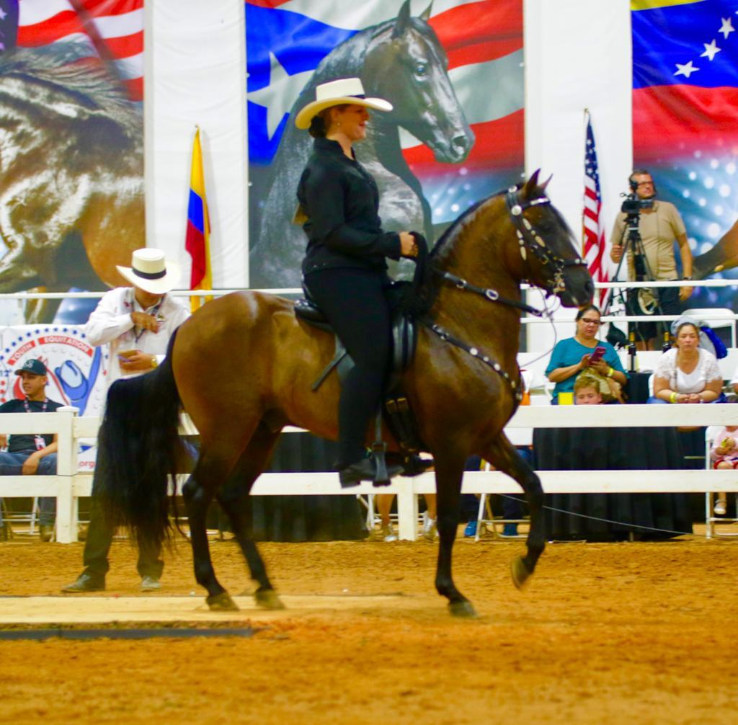
INTERNATIONAL EQUITATION
RIDING POSTURE

Slide 13
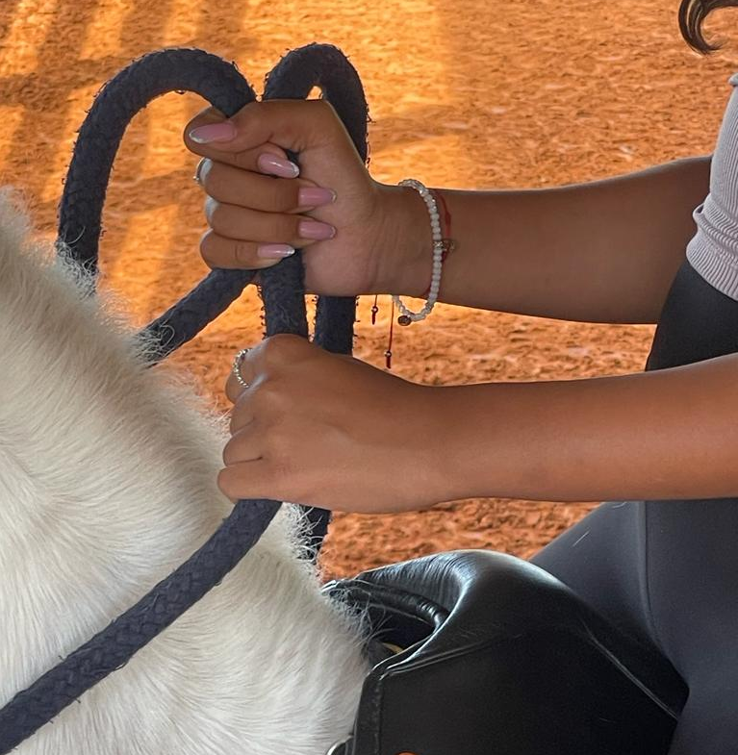
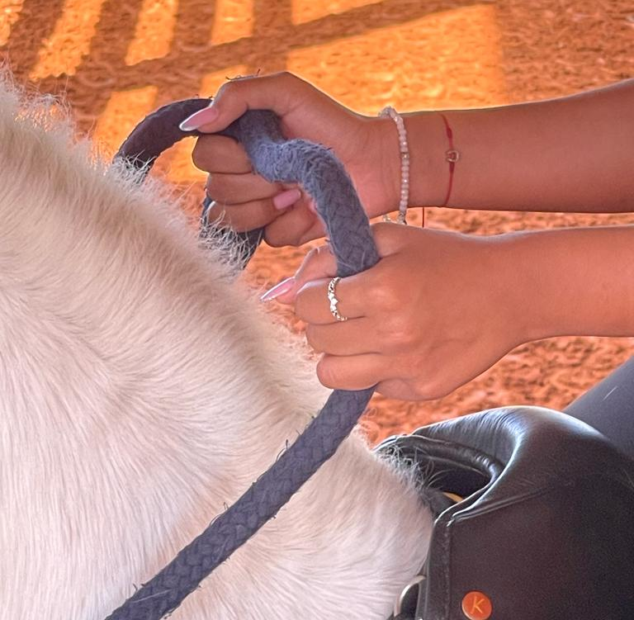
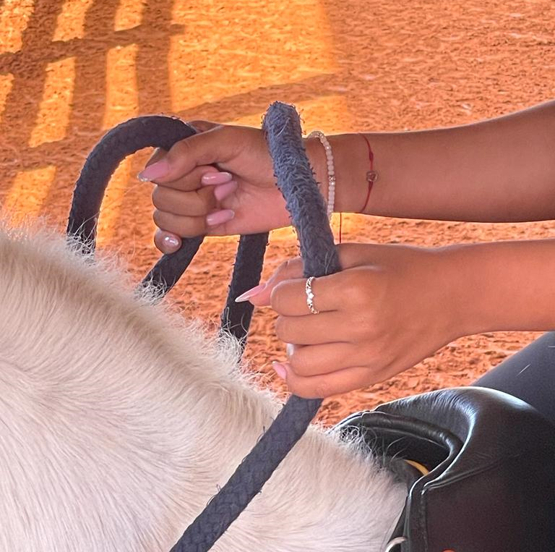
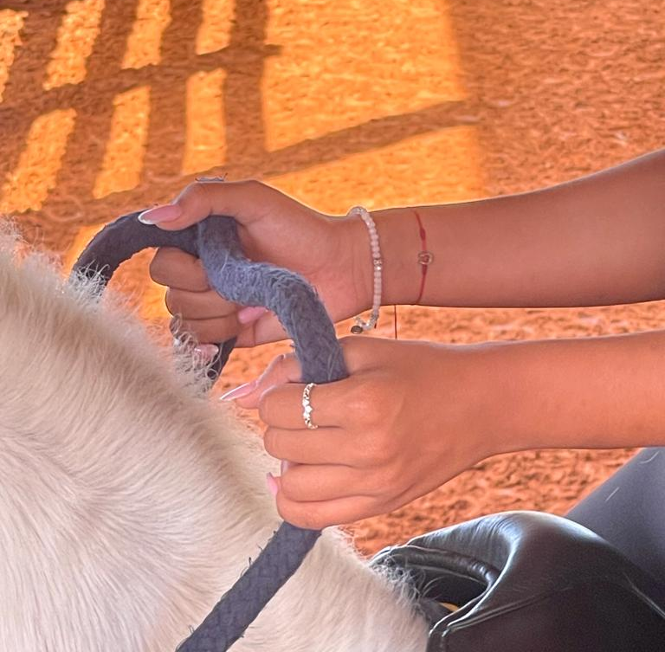
REIN HOLD
INTERNATIONAL
EQUITATION

Slide 14
INTERNATIONAL EQUITATION Procedure
Reverse
Sounding board in both direction
Figure 8
Halt
Back
Serpentine
Sounding board in both direction.

Slide 15
TIE BREACKER TESTS
INTERNATIONAL EQUITATION
Reverse 4x
Parallel comparison
Circles
Dismount and remount

